Slide 1

BANK LOAN
CASE STUDY
ASHIQ PAUL

Slide 2

PROJECT DESCRIPTION
This project focuses on understanding what drives some loan applicants to default, especially those with limited credit history. Using Excel, I explored the loan dataset to find patterns in customer and loan features. The goal was to help the company make smarter lending decisions, like knowing when to approve, reject, or adjust loan terms, based on real data.

Slide 3

APPROACH
01
Data Cleaning
02
Outlier Detection
Cleaned the data by identifying and handling missing values
Presentations are tools
that can be used as
speeches, reports,
and more.
03
Class Imbalance
Check
04
Univariate, Bivariate & Segmented Analysis
Looked at how many clients defaulted vs who didn’t
Explored each column to understand its distribution. Then compared groups and checked how features relate to defaulting.
05
Correlation Analysis
The approach I took for this case study
Found which features are most linked to defaults.

Slide 4






TECH-STACK
The Tech-Stacks I used for this case study
MICROSOFT EXCEL
CANVA / POWERPOINT
LOOM
MICROSOFT WORD / ACROBAT
Used for the cleaning of data, pivot table, calculations and chart visualizations
I used Canva for preparing and structuring this presentation. Presented on Microsoft Powerpoint
Used to record my screen for the video presentation
Microsoft Word Used for preparing and structuring the report and converting to PDF

Slide 5


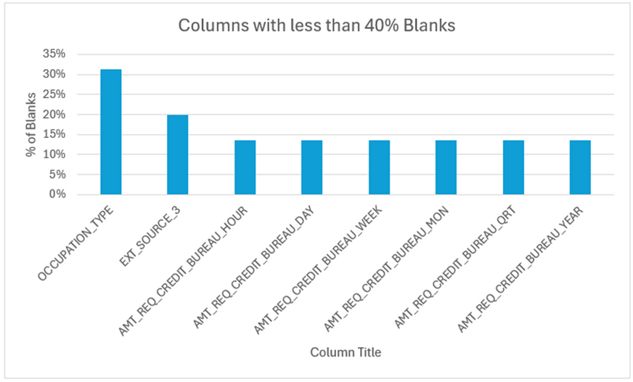
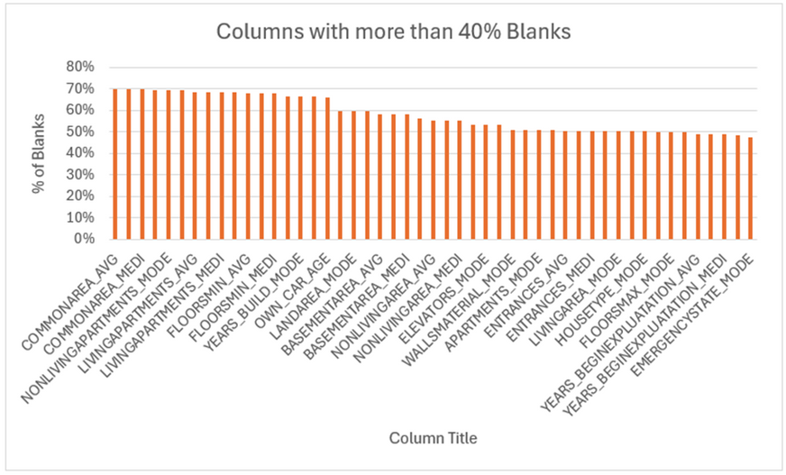
Missing Data Handling
Checked for blanks using the formula COUNTBLANK()
For numerical columns with <40% blanks, used MEDIAN() or AVERAGEIFS()
For categorical columns, used the most common value or filled with “Unknown”
Removed columns with >40% missing values
Highlighted changes using color codes:
Orange: Filled
Red: Dropped
Blue: Transformed

Slide 6
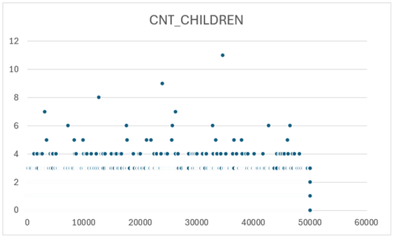
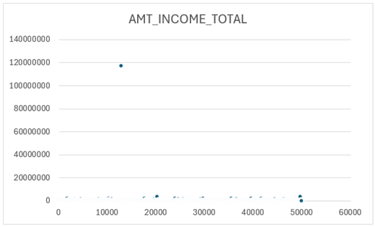
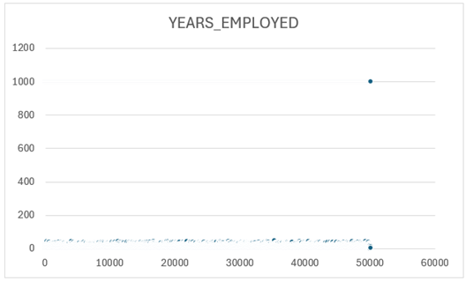
Outlier Detection
Used QUARTILE.EXC() to find Q1 and Q3, then calculated IQR
Flagged outliers that exceeded upper/lower limits
Examples:
1,000+ years of employment
117 million income
8+ children
These were either removed or noted as unrealistic

Slide 7
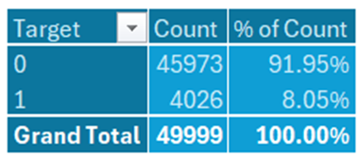
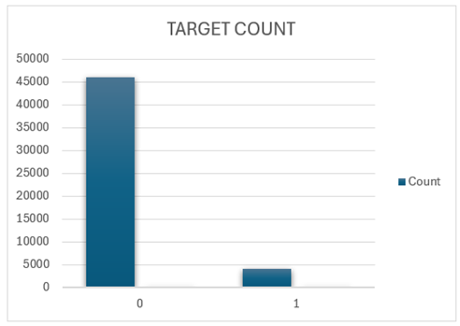
Class Imabalance
Target variable had heavy imbalance:
Class 0 (No default): 92%
Class 1 (Default): 8%
Visualized using pivot table and pie chart
Important to consider while building any prediction models

Slide 8
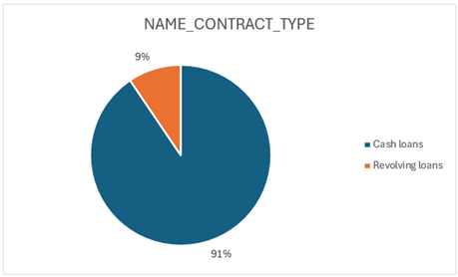
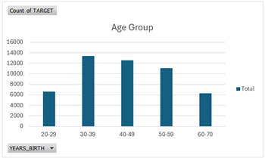
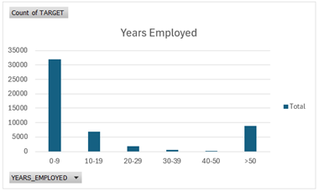
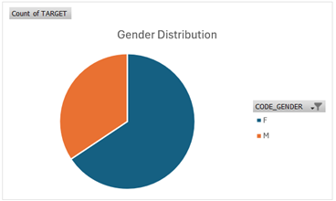
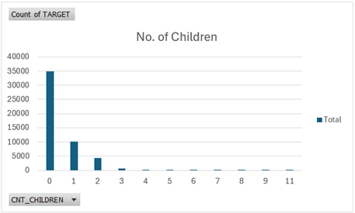
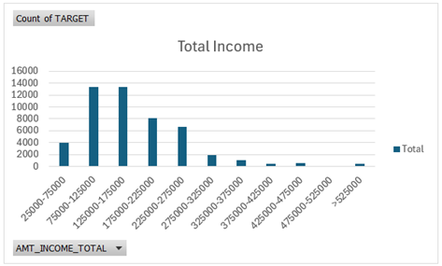
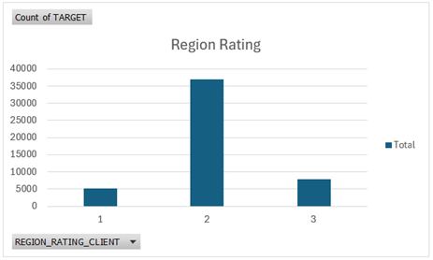
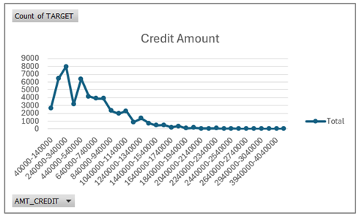
Univariate and Segmented Analysis
Most loan types: Cash Loans (91%)
Age group: Most applicants aged 30-39
Employment length: Majority had <9 years
Gender: More female applicants
Children: Most had none
Income: Many earned between 75k-175k
Education: Mostly Secondary/Secondary Special
Housing: Majority owned a House/Apartment
Region: Region 2 had the most applicants

Slide 9
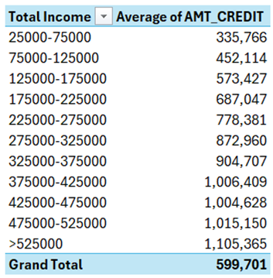
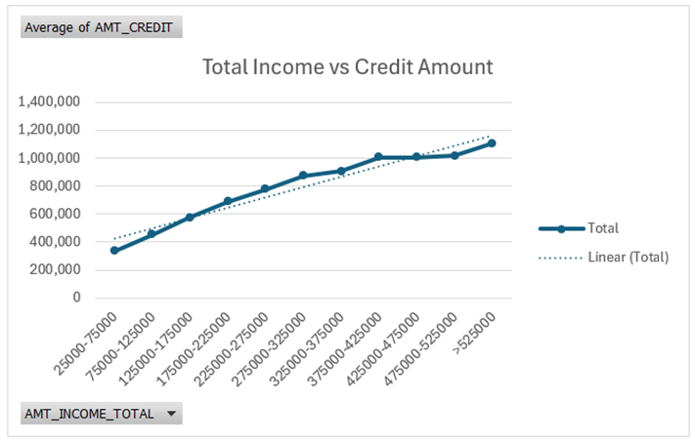
Bivariate and Correlation
Analyzed relationships between income and credit using trendlines
Segmented dataset into Target 0 and 1
Used CORREL() to find top correlations
Built a heatmap with conditional formatting
Key finding: Short employment, lower income, and certain loan types correlate strongly with default

Slide 10

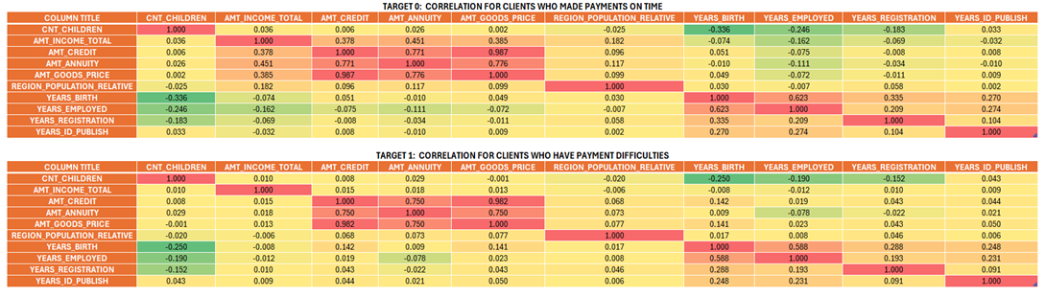

Slide 11
RESULT
Applicants with short job history, low income, or loans for consumer goods showed higher default risk
Gender values like “XNA” were flagged and corrected
The company can reduce risk by:
Adjusting approval filters
Offering smaller loan amounts or higher interest to high-risk profiles
Flagging profiles with multiple red flags for review

Slide 12

THANK YOU
TRAINITY

